Slide 1

21ES613 – Machine Learning for Embedded Applications
Plant Disease Detection using CNN
Batch No: 2
Team Members
CB.EN.P2EBS24003 Anish Arun Sandaye
CB.EN.P2EBS24006 Cheppalli Naga Sai Varun Reddy
Amrita School of Engineering, Coimbatore
Amrita Vishwa Vidyapeetham
1

Slide 2
Objectives
To develop an automated system for detecting and classifying apple leaf diseases using CNN.
To achieve a high level of accuracy
To reduce the time and effort required by farmers to manually detect diseases
2

Slide 3
Literature Survey
Year/Paper | Title | Remarks
2024 IEEE Conference | Detection and Classification of Plant Disease using Artificial Intelligence[1] | Four CNN models (GoogleNet, ResNet-18, AlexNet, and SqueezeNet) were evaluated for grapevine leaf disease classification. ResNet-18 achieved the highest performance accuracy
2022 IEEE Conference | Plant disease detection using convolution neural network | The CNN model achieved an average accuracy of 87%, with the best configuration reaching 95% accuracy. Despite its simplicity, the model proved efficient and accurate enough for practical use with randomized datasets.
2021 IEEE Journal | Plant Disease Detection and Classification by Deep Learning—A Review[2] | The use of different models like transfer learning, data augmentation, and visualization of CNN activation maps to enhance performance, but each model has its own limitations.
2020 IEEE Conference | Plant Disease Detection Using CNN[3] | Used basic CNN model classified 15 plant leaf cases, covering 12 diseased types and 3 healthy cases. Achieved an accuracy of 88.80% on the test set
3

Slide 4
Dataset Specification
Source: https://www.kaggle.com/competitions/plant-pathology-2020-fgvc7/data
Dataset Overview: Total images: 3,651 (training set)
Format: JPEG (.jpg)
Image resolution: High-resolution RGB images (varies per image)
Labels: Healthy, Multiple diseases, Rust, Scab
Class Descriptions:
Healthy: Leaf shows no signs of disease.
Rust: Characterized by small orange or yellow spots, typically fungal.
Scab: Dark, scabby lesions appearing on leaf surfaces.
Multiple diseases: The presence of more than one disease in the same image.
4

Slide 5
Methodology
Dataset
Data Preprocessing
EDA
Feature Extraction
Model Training
Model Validation & evaluation
5

Slide 6
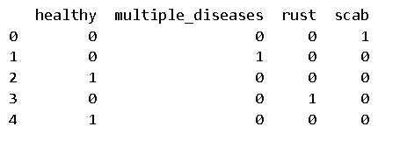
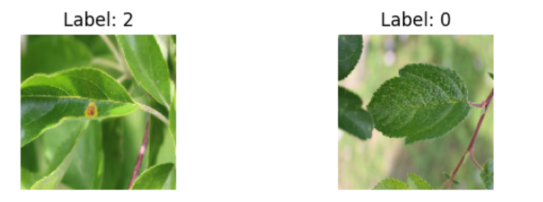
Step 1: Imort Libraries
os (Operating System Interface)
Pandas
numpy
TensorFlow
matplotlib
Fig. Multi-label binary classification
Step 2: Data Loading and Preprocessing
The dataset was loaded from a CSV file containing 1821 labeled plant leaf images.
Training samples: 1456, Validation samples: 365
Data Augmentation
Resizing and Normalization
6

Slide 7
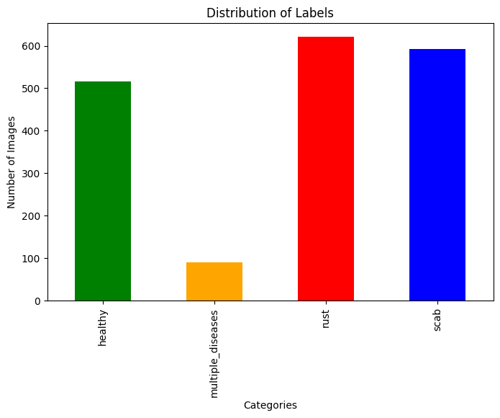
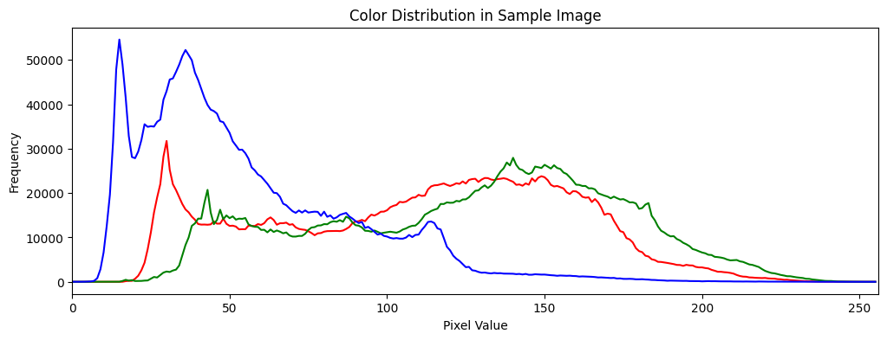
Step 3: EDA
Most Common Image Sizes:
Height | Width | Total Images
1365 | 2048 | 1819
2048 | 1365 | 2
Fig. Distribution of Labels
Fig. Colour Distribution in Sample image
7

Slide 8
Step 4: Feature Extraction
Input Image:128x128 with 3 channels
Convolution Layer1:
Applies 32 filters of size 3x3 to the input image..
Detects basic features like edges, corners, and textures.
ReLU:
Adds non-linearity to help learn complex patterns.
Max Pooling Layer:
Reduces spatial size by taking the max value from a 2x2 window..
Downsamples the image to reduce computation and prevent overfitting.
Convolution Layer2:
Applies 64 filters to the down sampled image.
Learns more complex features from the previous layer's output.
ReLU:
Adds non-linearity to help learn complex patterns.
Max Pooling Layer:
Further down sampling.
Focuses on the most important features.
8

Slide 9
Convolution Layer3:
Uses 128 filters to extract even higher-level features.
Detects complex patterns like shapes or textures.
ReLU:
Adds non-linearity to help learn complex patterns.
Max Pooling Layer:
Final down sampling stage before flattening..
Flatten Layer:
Converts the 3D output of convolutions into a 1D vector.
Dense Layer:
Fully connected layer with 64 neurons.
Learns non-linear combinations of features for classification.
ReLU:
Adds non-linearity to help learn complex patterns.
Dropout:
Randomly turns off 50% of the neurons during training. Prevents overfitting and improves generalization
Dense Layer:
Final output layer.
Outputs class probabilities for each category.
SoftMax:
Ensures the output adds up to 1 (like probabilities).
9

Slide 10
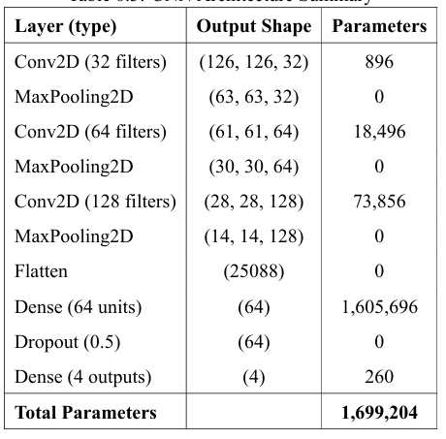
Flatten
Input Layer
Conv2D
MaxPooling2D
Conv2D_1
MaxPooling2D_1
Conv2D_2
MaxPooling2D_2
10

Slide 11
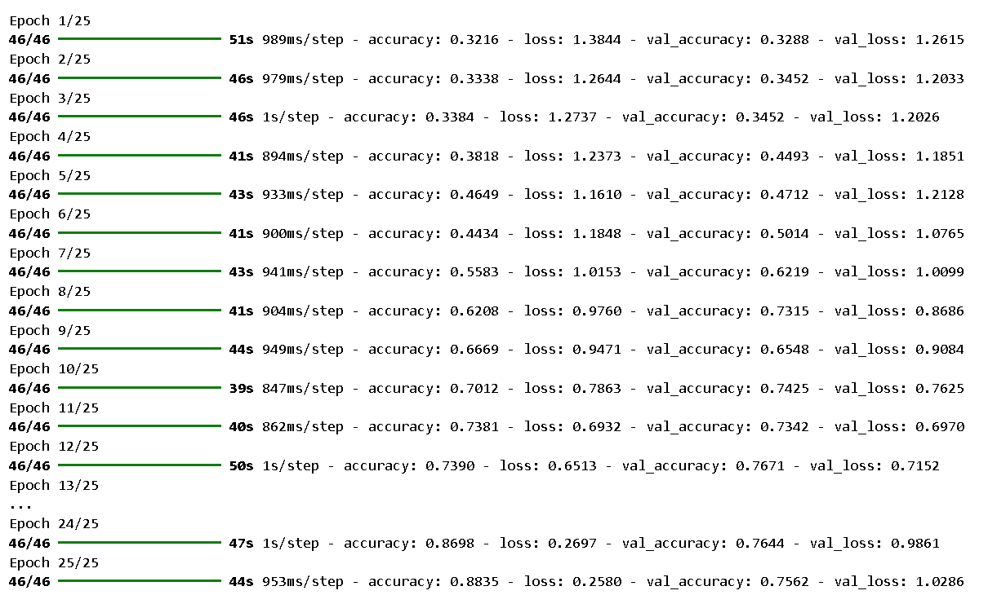
Step 5: Model Training
Adam Optimizer:
Adaptive Learning: Adjusts learning rate for each parameter (no manual tuning for each layer)
Fast Convergence: Typically faster than SGD or Momentum alone
Works Well by Default: Commonly works great with minimal tuning (learning_rate=0.001)
The model adjusts its weights using gradient descent (via adam optimizer).
Training was run for several epochs with data augmentation enabled to mitigate class imbalance.
11

Slide 12
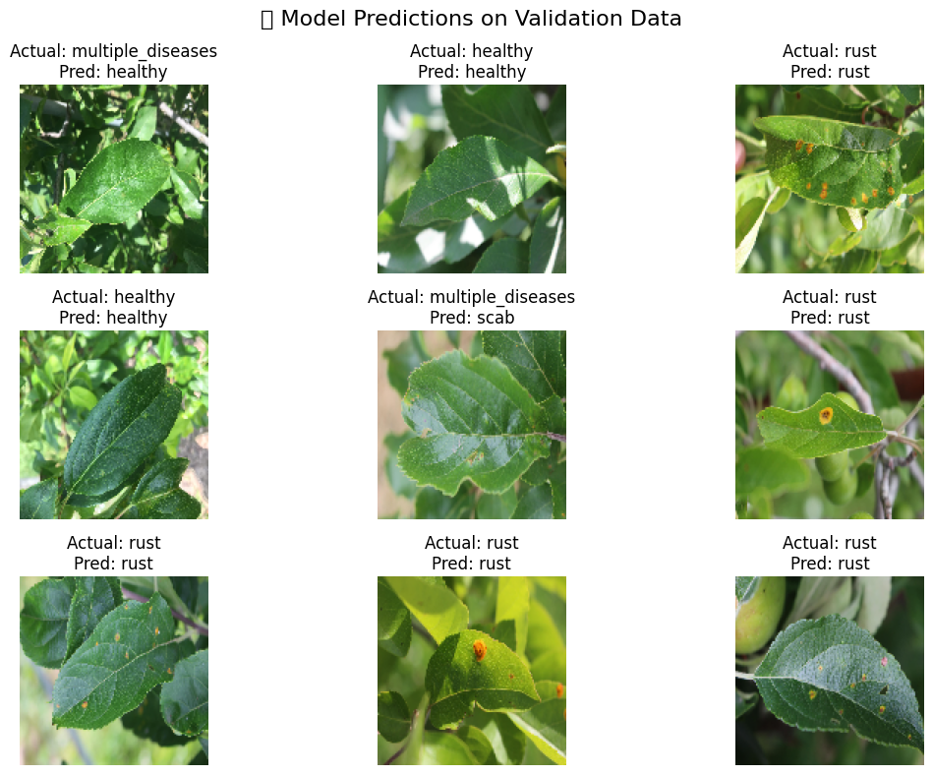
Step 6: Model Validation and Evaluation
Model performance was evaluated on a validation set of 365 images.
Accuracy measures how well the model has learned the classification.
12

Slide 13
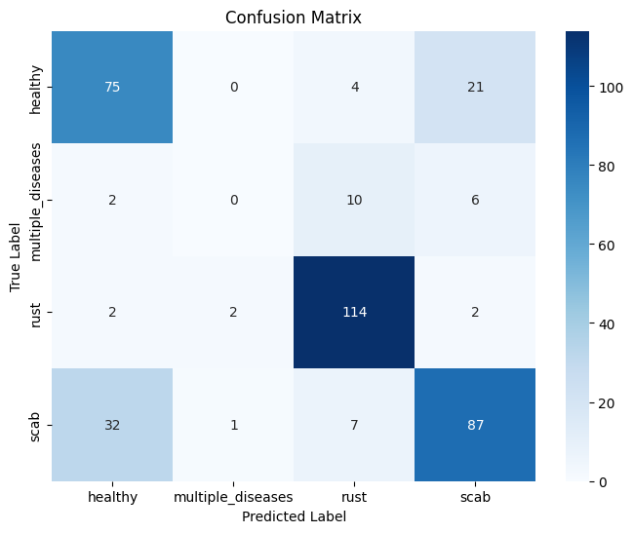
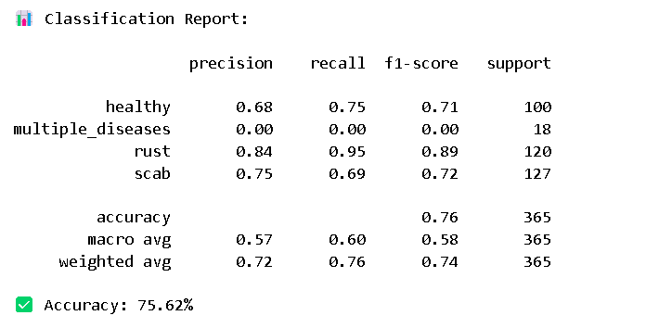
13

Slide 14
Conclusion
This project demonstrates the effectiveness of using deep learning, specifically Convolutional Neural Networks (CNNs), for automated plant disease detection based on leaf images.
The complete pipeline—from image preprocessing and exploratory data analysis to CNN-based feature extraction, training, evaluation, and deployment— was successfully implemented with a focus on real-time, on-device diagnosis.
A custom CNN architecture was developed to learn visual features directly from the images. The trained model was validated using multiple performance metrics and achieved competitive results, particularly in detecting rust and scab diseases. Although the model struggled with the underrepresented ‘multiple diseases‘ class, it showed promising generalization for the remaining categories.
14

Slide 15
References
[1] S. Singh and S. Jain, "Detection and Classification of Plant Disease using Artificial Intelligence," in 2024 11th International Conference on Reliability, Infocom Technologies and Optimization (Trends and Future Directions) (ICRITO), Noida, India, 2024, pp. 1-6. doi: 10.1109/ICRITO61523.2024.10522449.
[2] L. Li, S. Zhang, and B. Wang, "Plant Disease Detection and Classification by Deep Learning—A Review," IEEE Access, vol. 9, pp. 1-15, Apr. 2021. doi: 10.1109/ACCESS.2021.3069646.
[3] G. Shrestha, Deepsikha, and M. Das, "Plant Disease Detection Using CNN," in Proceedings of 2020 IEEE Applied Signal Processing Conference (ASPCON), Kolkata, India, 2020, pp. 1-5. doi: 10.1109/ASPCON49795.2020.9276493.
[4] S. Ramesh, N. M., P. R., P. Bhat N., and S. N., "Plant Disease Detection Using Machine Learning," 2018 International Conference on Design Innovations for 3Cs Compute Communicate Control (ICDI3C), Bangalore, India, 2018, pp. 41-45, doi: 10.1109/ICDI3C.2018.00017
[5] "Figure 18 - Evaluation and Comparison of Models," National Center for Biotechnology Information (NCBI), available at: https://www.ncbi.nlm.nih.gov/books/NBK597497/figure/ch3.Fig18/.
[6] S. Siddhardhan, "Plant Disease Prediction Using CNN Deep Learning Project," GitHub, available at: https://github.com/siddhardhan23/plant-disease-prediction-cnn-deep-leanring-project/blob/main/model_training_notebook/Plant_Disease_Prediction_CNN_Image_Classifier.ipynb.
[7] A. M. A. Karol, D. Gulhane, and T. Chandiwade, "Plant Disease Detection using CNN & Remedy," International Journal of Advanced Research in Electrical, Electronics and Instrumentation Engineering, vol. 8, no. 3, pp. 622-628, Mar. 2019. DOI: 10.15662/IJAREEIE.2019.0803014.
15

